Slide 1






SCIENTIFIC
CALCULATOR

Slide 3
Introduction
Title: Scientific Calculator
The scientific calculator is a versatile tool designed to perform a wide range of mathematical operations, from basic arithmetic to advanced functions such as trigonometry and logarithms. This project aims to create a user-friendly console-based calculator that enhances computational efficiency and accuracy, making it an essential resource for students, engineers, and anyone involved in mathematical tasks.

Slide 5
Difference Between Manual & Programmed Calculator
Manual Calculation:
Involves performing calculations by hand or using basic calculators.
Prone to human error and time-consuming for complex operations.
Limited to basic functions without advanced mathematical capabilities.
Programmed Calculator:
Automates calculations through coded algorithms, ensuring accuracy and speed.
Supports a wide range of functions, including trigonometric, logarithmic, and hyperbolic calculations.
Provides a user-friendly interface that enhances the user experience and allows for quick access to various operations.

Slide 7
Purpose
The primary purpose of this scientific calculator project is to provide users with a reliable and efficient tool for performing complex mathematical calculations. By integrating various functions and ensuring ease of use, the calculator aims to facilitate learning, improve productivity, and support users in academic and professional settings.

Slide 8
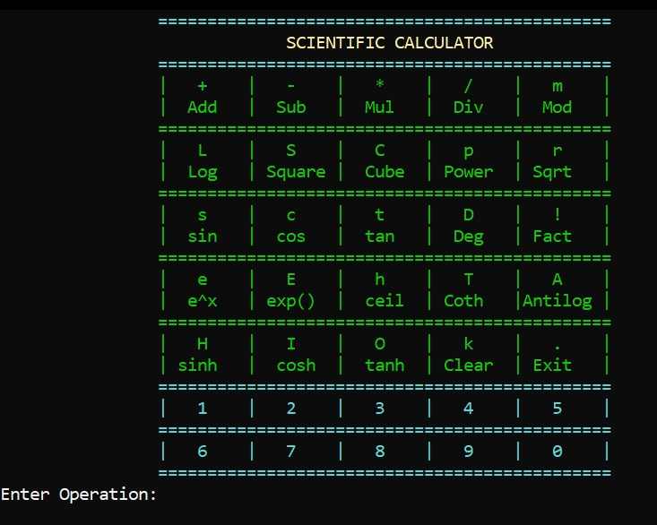

Slide 9
Output Screenshot Description
The output of the scientific calculator is displayed in a console window, showcasing the current result of calculations along with a clear and organized menu of available operations.

Slide 10
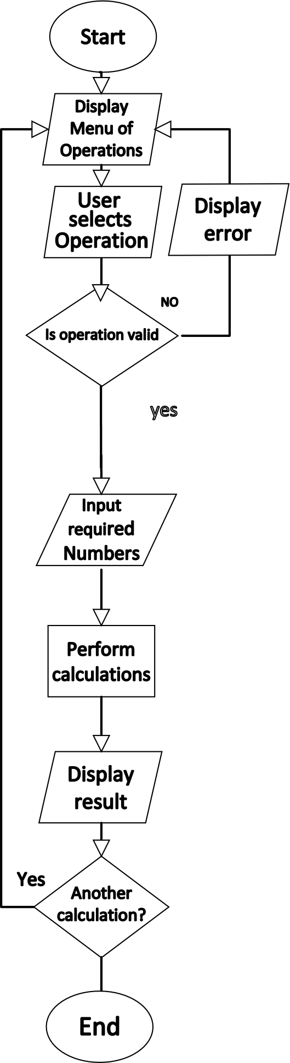

Slide 11
Flowcharts Description
Flowcharts illustrate the logical flow of the calculator's operations, detailing how user inputs are processed. The flowchart begins with the user selecting an operation, followed by inputting numbers. It then branches based on the operation chosen, leading to the execution of the corresponding mathematical function. Error handling is also depicted, showing how the program responds to invalid inputs or special cases, such as division by zero.

Slide 12



Slide 13
Conclusion
In conclusion, the scientific calculator project successfully combines a wide range of mathematical functions with a user-friendly interface, making it an invaluable tool for anyone needing to perform calculations. By automating complex operations and providing robust error handling, the calculator enhances accuracy and efficiency in mathematical problem-solving. This project not only serves educational purposes but also has the potential for future enhancements, ensuring its relevance in various fields.
Functionalities
The scientific calculator includes a variety of functionalities:
Basic arithmetic operations: addition, subtraction, multiplication, and division.
Advanced functions: logarithm, exponentiation, square root, and factorial.
Trigonometric functions: sine, cosine, tangent, and their inverses.
Hyperbolic functions: sinh, cosh, tanh, and coth.
Error handling for invalid inputs and special cases.
User-friendly console interface with color-coded outputs for clarity.

Slide 14
Conclusion
In conclusion, the scientific calculator project successfully combines a wide range of mathematical functions with a user-friendly interface, making it an invaluable tool for anyone needing to perform calculations. By automating complex operations and providing robust error handling, the calculator enhances accuracy and efficiency in mathematical problem-solving. This project not only serves educational purposes but also has the potential for future enhancements, ensuring its relevance in various fields.
Functionalities
The scientific calculator includes a variety of functionalities:
Basic arithmetic operations: addition, subtraction, multiplication, and division.
Advanced functions: logarithm, exponentiation, square root, and factorial.
Trigonometric functions: sine, cosine, tangent, and their inverses.
Hyperbolic functions: sinh, cosh, tanh, and coth.
Error handling for invalid inputs and special cases.
User-friendly console interface with color-coded outputs for clarity.

Slide 15
Conclusion
In conclusion, the scientific calculator project successfully combines a wide range of mathematical functions with a user-friendly interface, making it an invaluable tool for anyone needing to perform calculations. By automating complex operations and providing robust error handling, the calculator enhances accuracy and efficiency in mathematical problem-solving. This project not only serves educational purposes but also has the potential for future enhancements, ensuring its relevance in various fields.
Functionalities
The scientific calculator includes a variety of functionalities:
Basic arithmetic operations: addition, subtraction, multiplication, and division.
Advanced functions: logarithm, exponentiation, square root, and factorial.
Trigonometric functions: sine, cosine, tangent, and their inverses.
Hyperbolic functions: sinh, cosh, tanh, and coth.
Error handling for invalid inputs and special cases.
User-friendly console interface with color-coded outputs for clarity.

Slide 16
Conclusion
In conclusion, the scientific calculator project successfully combines a wide range of mathematical functions with a user-friendly interface, making it an invaluable tool for anyone needing to perform calculations. By automating complex operations and providing robust error handling, the calculator enhances accuracy and efficiency in mathematical problem-solving. This project not only serves educational purposes but also has the potential for future enhancements, ensuring its relevance in various fields.
Functionalities
The scientific calculator includes a variety of functionalities:
Basic arithmetic operations: addition, subtraction, multiplication, and division.
Advanced functions: logarithm, exponentiation, square root, and factorial.
Trigonometric functions: sine, cosine, tangent, and their inverses.
Hyperbolic functions: sinh, cosh, tanh, and coth.
Error handling for invalid inputs and special cases.
User-friendly console interface with color-coded outputs for clarity.

Slide 17
Conclusion
In conclusion, the scientific calculator project successfully combines a wide range of mathematical functions with a user-friendly interface, making it an invaluable tool for anyone needing to perform calculations. By automating complex operations and providing robust error handling, the calculator enhances accuracy and efficiency in mathematical problem-solving. This project not only serves educational purposes but also has the potential for future enhancements, ensuring its relevance in various fields.
Functionalities
The scientific calculator includes a variety of functionalities:
Basic arithmetic operations: addition, subtraction, multiplication, and division.
Advanced functions: logarithm, exponentiation, square root, and factorial.
Trigonometric functions: sine, cosine, tangent, and their inverses.
Hyperbolic functions: sinh, cosh, tanh, and coth.
Error handling for invalid inputs and special cases.
User-friendly console interface with color-coded outputs for clarity.

Slide 18


